Slide 1
Analyse Massa Spectra
I.Paffen, HAN 20-10-2016

Slide 2
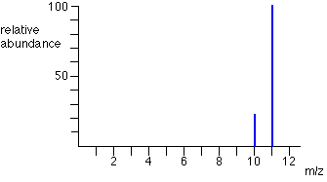
Massa Spectrum van één element
The mass spectrum for boron
The two isotopes (with their relative abundances) are:
boron-10 |  | 23
boron-11 |  | 100
10.8 is the relative atomic mass of boron.
http://www.chemguide.co.uk/analysis/masspec/elements.html#top
Notes:
A "weighted average" allows for the fact that there won't be equal amounts of the various isotopes. The example coming up should make that clear.
Suppose you had 123 typical atoms of boron. 23 of these would be ¹⁰B and 100 would be ¹¹B.
The total mass of these would be (23 x 10) + (100 x 11) = 1330
The average mass of these 123 atoms would be 1330 / 123 = 10.8 (to 3 significant figures).
10.8 is the relative atomic mass of boron.
Notice the effect of the "weighted" average. A simple average of 10 and 11 is, of course, 10.5. Our answer of 10.8 allows for the fact that there are a lot more of the heavier isotope of boron - and so the "weighted" average ought to be closer to that.

Slide 3
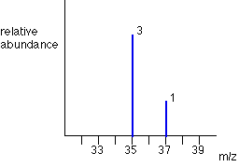
Massa spectrum van Cl₂
Chlorine has two isotopes, ³⁵Cl and ³⁷Cl, in the approximate ratio of 3 atoms of ³⁵Cl to 1

Slide 4
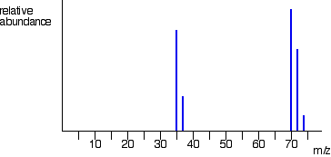
Fragmentatie patroon van Cl₂
http://www.chemguide.co.uk/analysis/masspec/elements.html#top

Slide 5

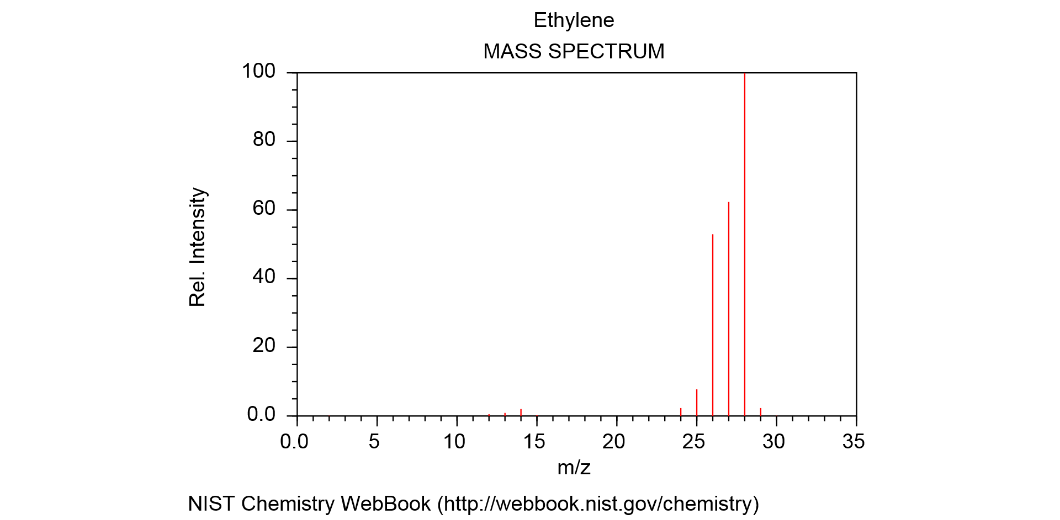
Ethyleen
Formula: C₂H₄
Molecular weight: 28.0532
Chemical structure:
http://webbook.nist.gov/cgi/cbook.cgi?Spec=C74851&Index=0&Type=Mass&Large=on&SVG=on

Slide 6
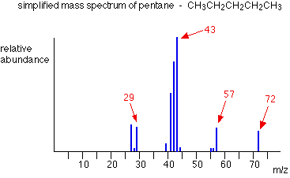
http://www.chemguide.co.uk/analysis/masspec/pentanemspec.GIF

Slide 7
Spectum of dipeptide
You have analyzed a sample by MS of which you know it contains a dipeptide. A single peak with an m/zof 329 [M+H]+was found. The results of the amino acid composition was not really clear but it showed that the peptide was composed of only aromatic amino acids. (fenylalanine Mw=165, tryptophane Mw = 204, tyrosine Mw = 181)
Of which amino acids is the peptide composed?

Slide 8
Bronnen
Voor de afbeeldingen is het internet geraadpleegd op 20-10-2016

